Slide 1
SeqGAN: Sequence Generative Adversarial Nets with Policy Gradient
AAAI 2017
Lantao Yu, Weinan Zhang, Jun Wang, Yong Yu
Shanghai Jiao Tong University, University College London

Slide 2
Generating sequential data
Maximize the log predictive likelihood of each true token given the previous observed tokens (Salakhutdinov 2009)
Exposure bias in the inference stage (Bengio et al. 2015)
Scheduled sampling (SS) (Bengio et al. 2015)
Build the loss function on the entire generated sequence instead of each transition

Slide 3
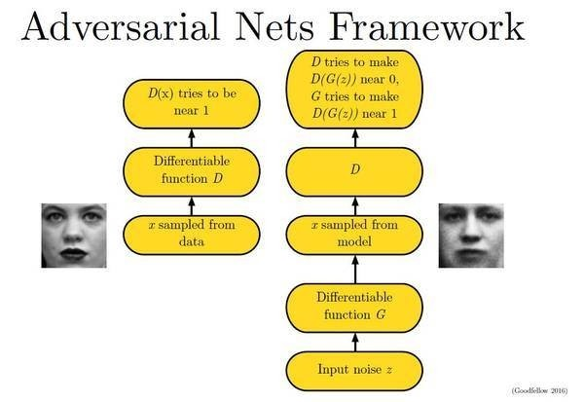
GAN

Slide 4
Problem in Generating Sequences
The discrete outputs from the generative model make it difficult to pass the gradient update from the discriminative model to the generative model.
GAN can only give the score/loss for an entire sequence when it has been generated; for a partially generated sequence, it is non-trivial to balance how good as it is now and the future score as the entire sequence

Slide 5
SeqGAN
Consider the sequence generation procedure as a sequential decision making process
The generative model is treated as an agent of reinforcement learning (RL)
The state is the generated tokens so far and the action is the next token to be generated
Employ a discriminator to evaluate the sequence as reward

Slide 6
Generative model
Solve the problem that the gradient cannot pass back to the generative model when the output is discrete
Regard the generative model as a stochastic parametrized policy
Employ Monte Carlo (MC) search to approximate the state-action value
Train the policy (generative model) via policy gradient which naturally avoids the differentiation difficulty for discrete data in a conventional GAN.

Slide 7
Sequence Generative Adversarial Nets
Problem Def.
Given a dataset of real-world structured sequences, train a θ-parameterized generative model to produce a sequence
where is the vocabulary of candidate tokens.

Slide 8
Sequence Generative Adversarial Nets
In timestep t
State(current produced tokens):
Action(next token to select):
Policy model:
the state transition is deterministic after an action has been chosen

Slide 9
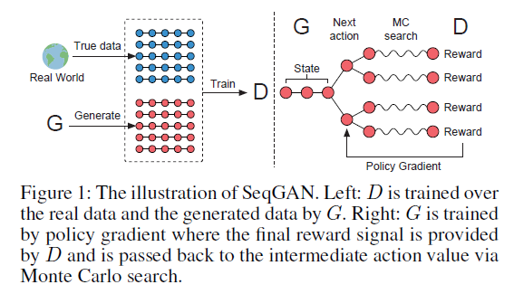
Sequence Generative Adversarial Nets

Slide 10
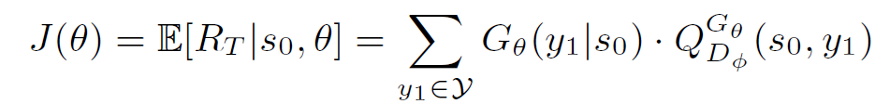

SeqGAN via Policy Gradient
The objective of the generator model (policy) is to generate a sequence from the start state to maximize its expected end reward
is the action-value function of a sequence, the expected accumulative reward starting from state s, taking action a, and then following policy

Slide 11
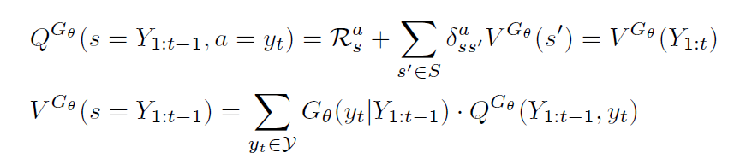
SeqGAN via Policy Gradient
Action value and state value

Slide 12

SeqGAN via Policy Gradient
Estimate the action-value function
However, the discriminator only provides a reward value for a finished sequence

Slide 13
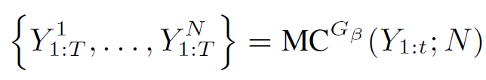
SeqGAN via Policy Gradient
To evaluate the action-value for an intermediate state, we apply Monte Carlo search with a roll-out policy to sample the unknown last T-t tokens

Slide 14
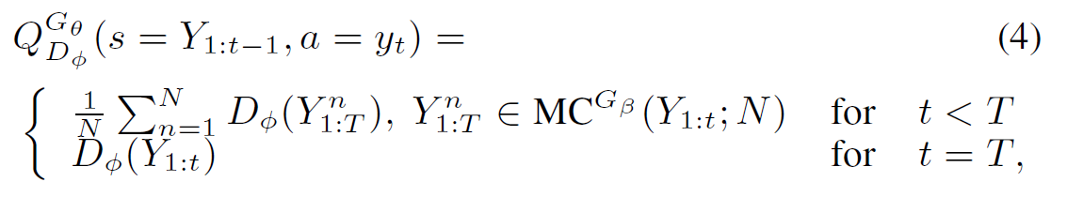
SeqGAN via Policy Gradient
Evaluate the action-value for an intermediate state

Slide 15
SeqGAN via Policy Gradient
Discriminator model

Slide 16
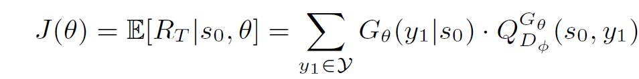
SeqGAN via Policy Gradient
Generator model

Slide 17
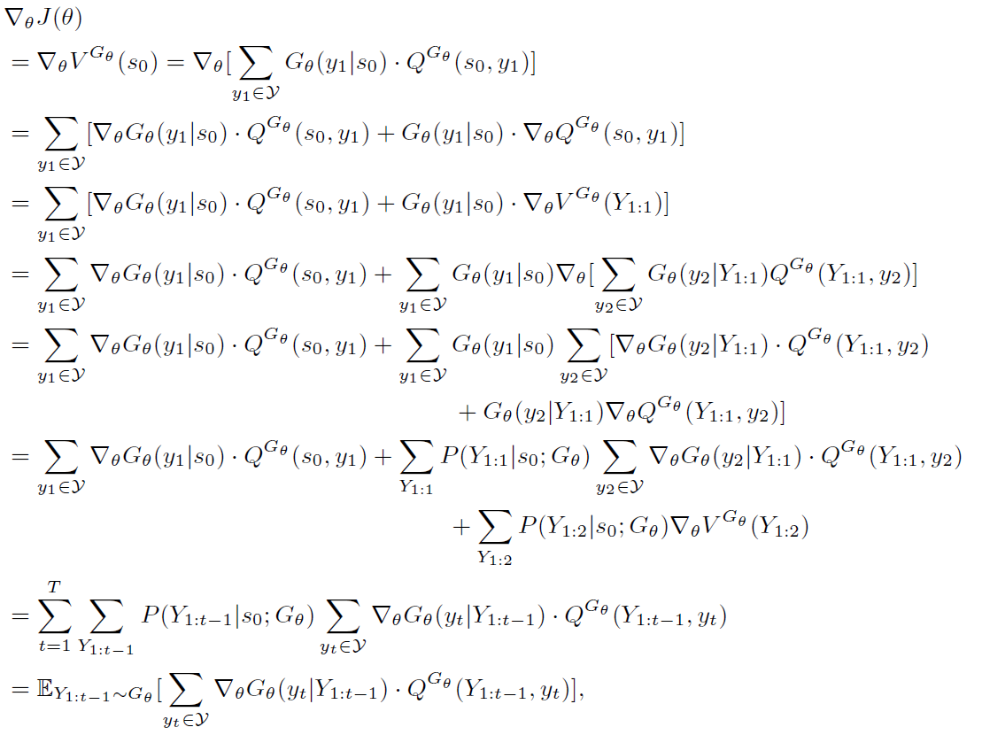

Slide 18
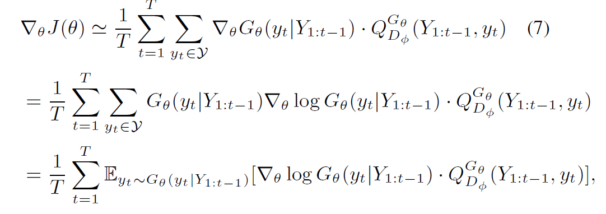
SeqGAN via Policy Gradient
Using likelihood ratios (Glynn1990; Sutton et al. 1999), we build an unbiased estimation:

Slide 19
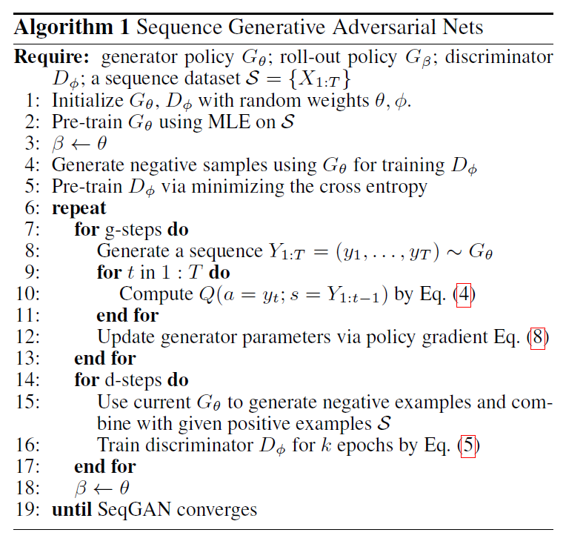

Slide 20

The Generative Model for Sequences
Use recurrent neural networks (RNNs) (Hochreiter and Schmidhuber 1997) as the generative model

Slide 21



The Discriminative Model for Sequences
Choose the CNN as discriminator
A fully connected layer with sigmoid activation is used to output the probability that the input sequence is real

Slide 22


Synthetic Data Experiments
Use a randomly initialized LSTM as the true model, aka, the oracle, to generate the real data distribution for the following experiments

Slide 23
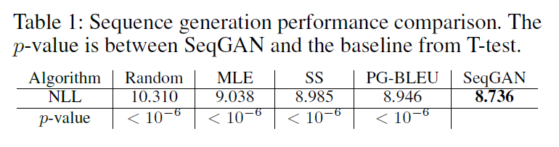
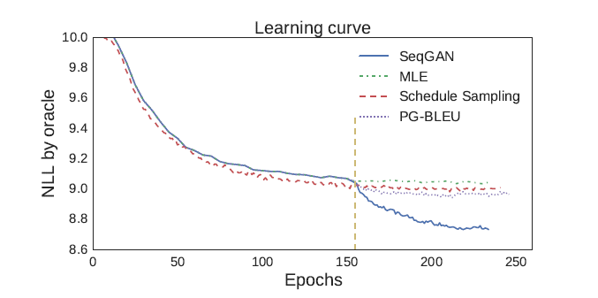
Synthetic Data Experiments

Slide 24
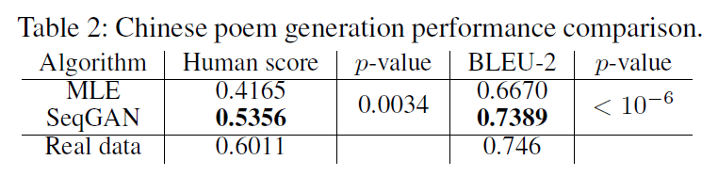
Real-world Scenarios
Chinese poems
“For poem evaluation, we set n-gram to be 2 (BLEU-2) since most words (dependency) in classical
Chinese poems consist of one or two characters”
“Specifically, we mix the 20 real poems and 20 each generated from SeqGAN and MLE. Then 70 experts on Chinese poems are invited to judge whether each of the 60 poem is created by human or machines”

Slide 25
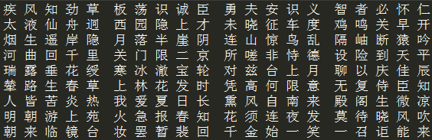
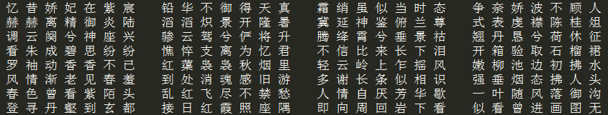
Chinese poems

Slide 26
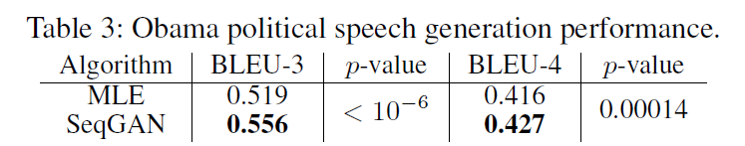
Barack Obama political speeches

Slide 27
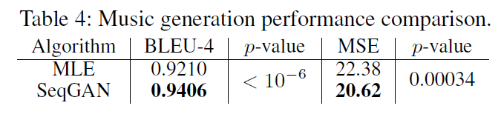
Music Generation
“Use Nottingham6 dataset as our training data, which is a collection of 695 music of folk tunes in midi file format”

Slide 28
Conclusion
Proposed a sequence generation method, SeqGAN, to effectively train generative adversarial nets for structured sequences generation via policy gradient

